Slide 1
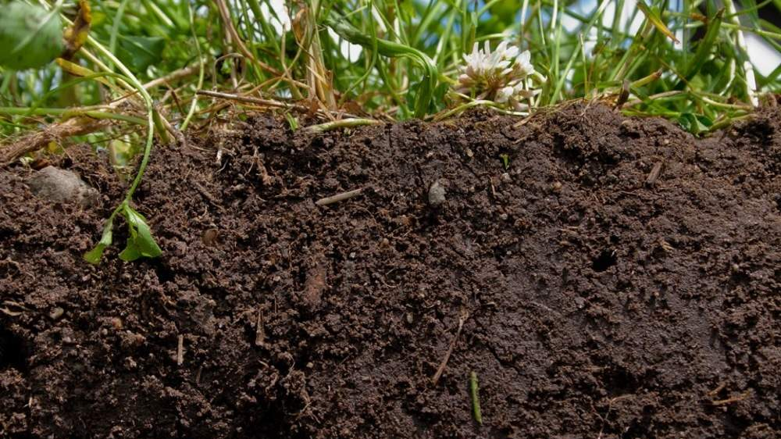
Soil Aggregate Stability Research Proposal
Rocio Hernandez

Slide 2
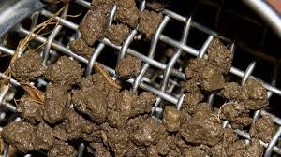
Introduction/Background
Stemming from a Larger Project
Soil aggregates indicator of health
Agriculture Land Management
Problem: Soil Degradation

Slide 3
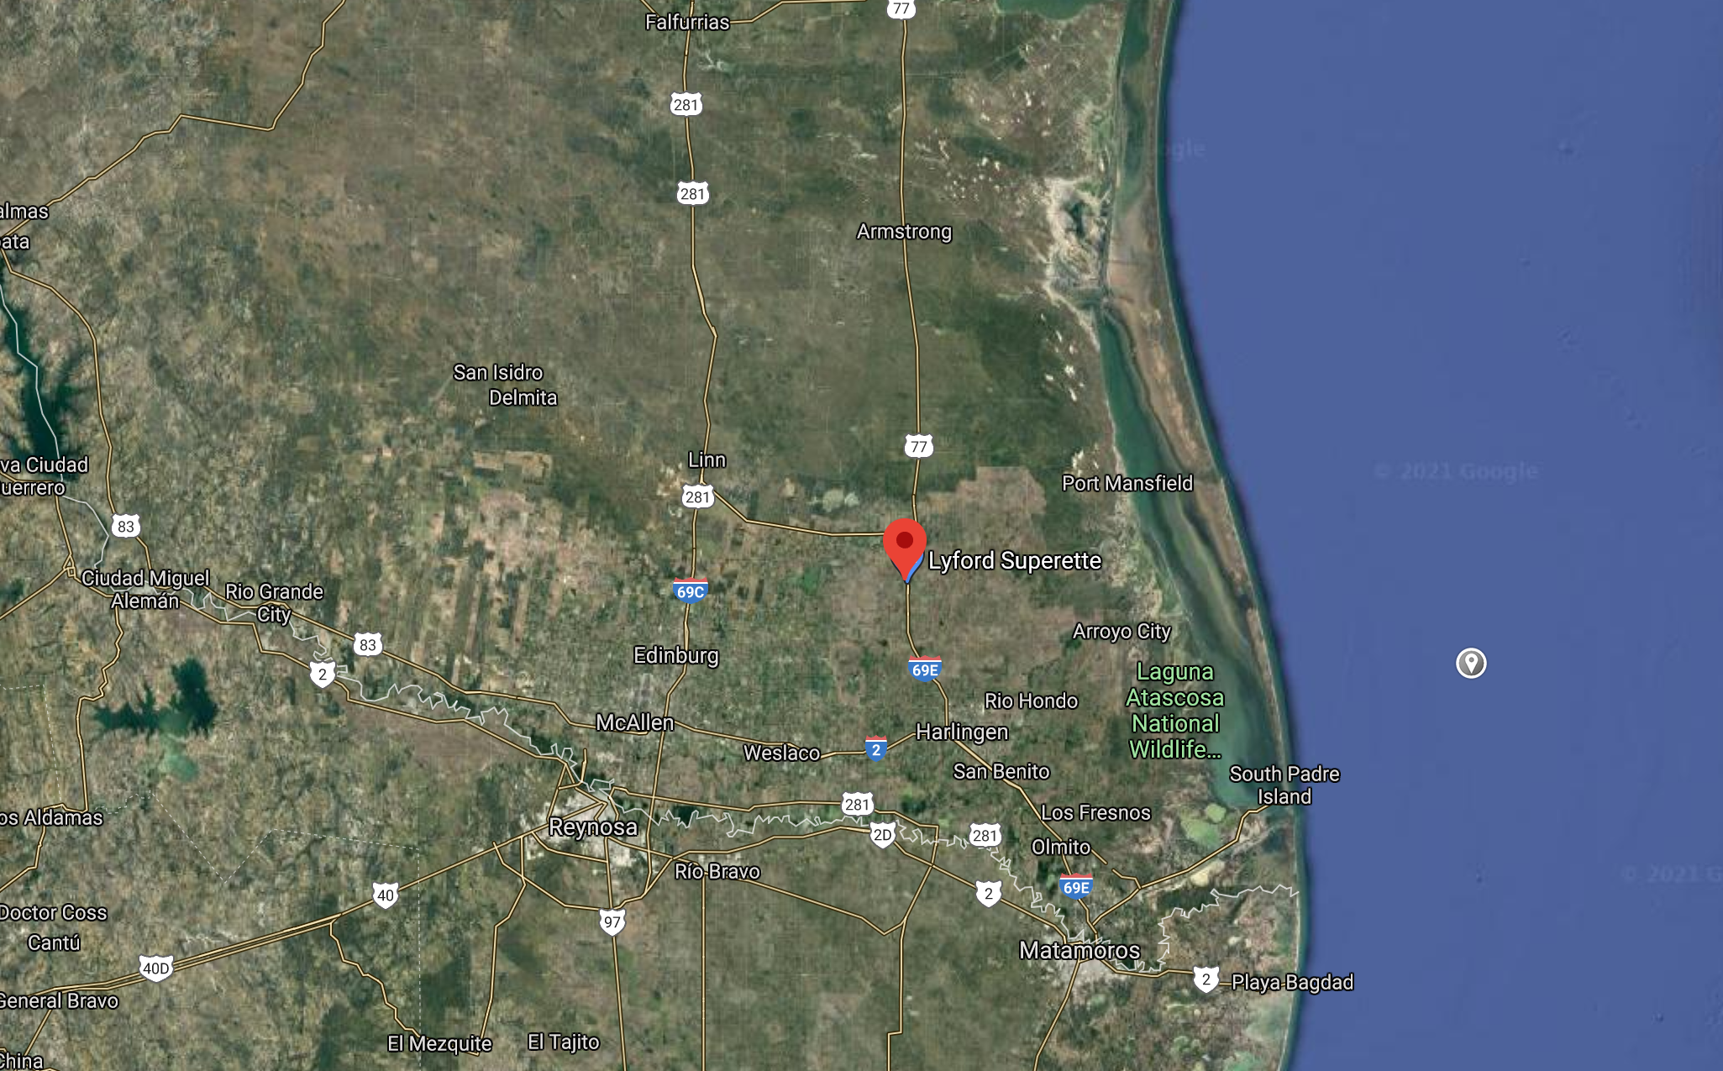
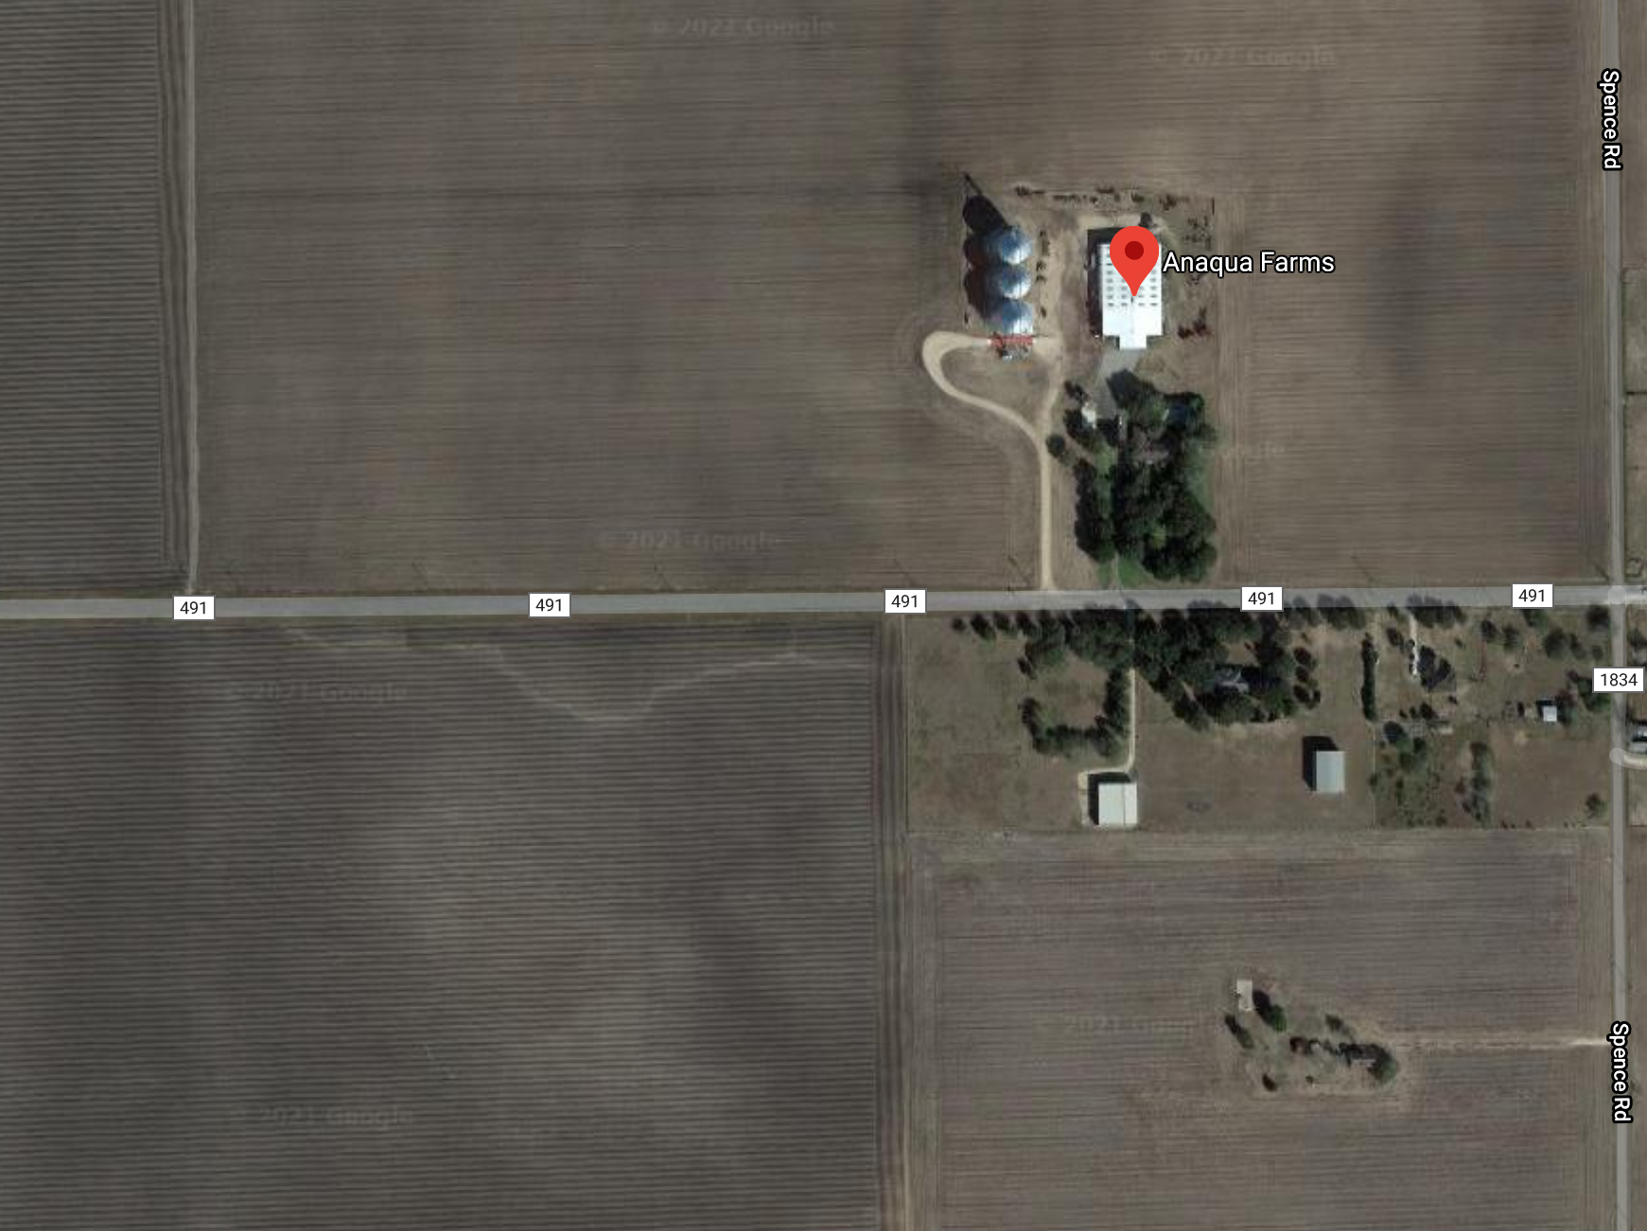
Study Site
Location: Anaqua Farms
Samples: 18
Tillage Practices: Conventional, intermittent and strip tillage.

Slide 4
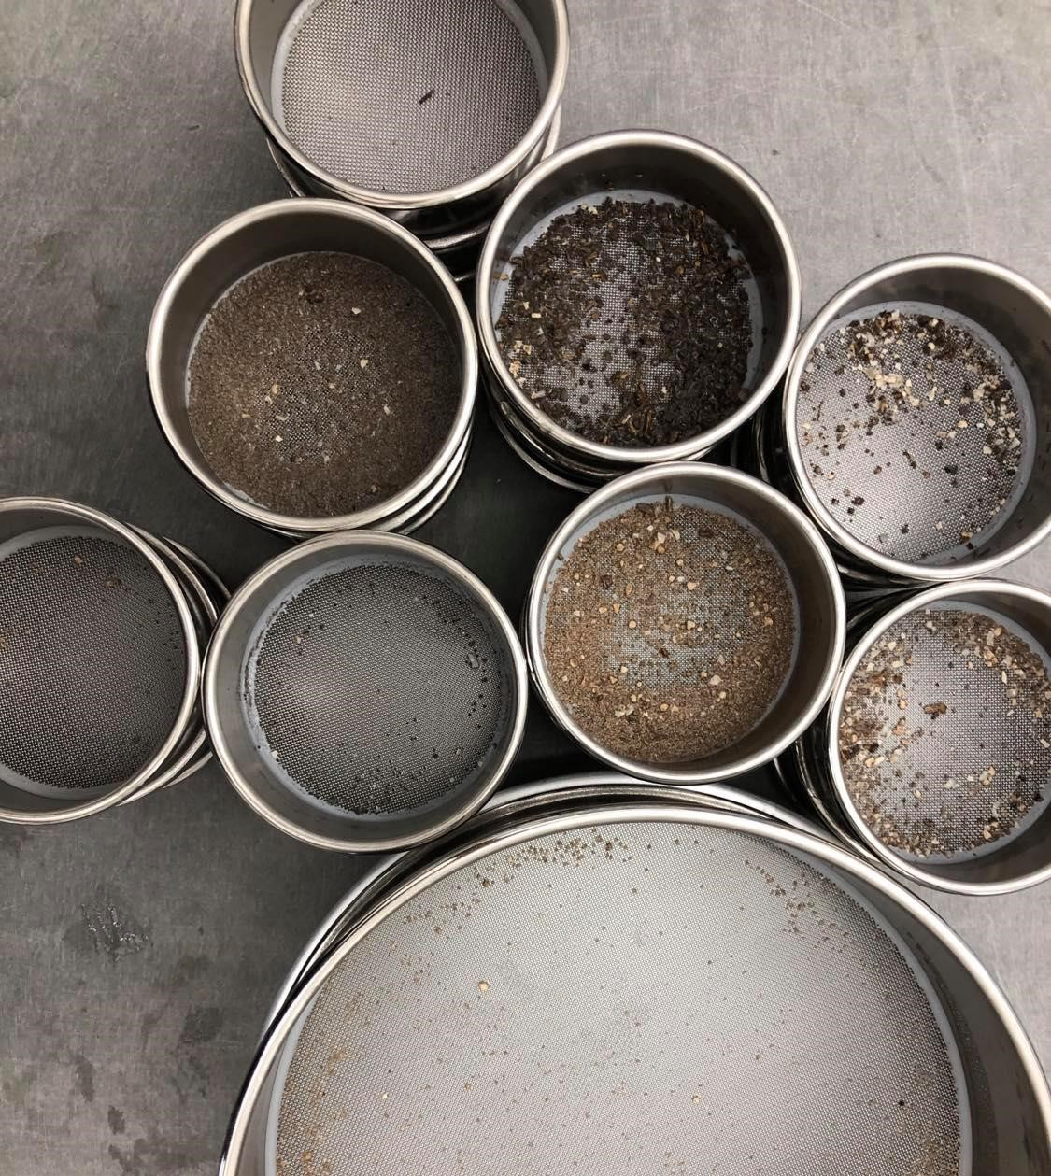
Research Hypothesis
Q: Will tillage type affect the stability of soil aggregates within the soil.
Hypothesis: Soils that have been strip (conservation) tilled have a higher percentage of aggregate stability than soils that have been conventionally or intermittently tilled.

Slide 5
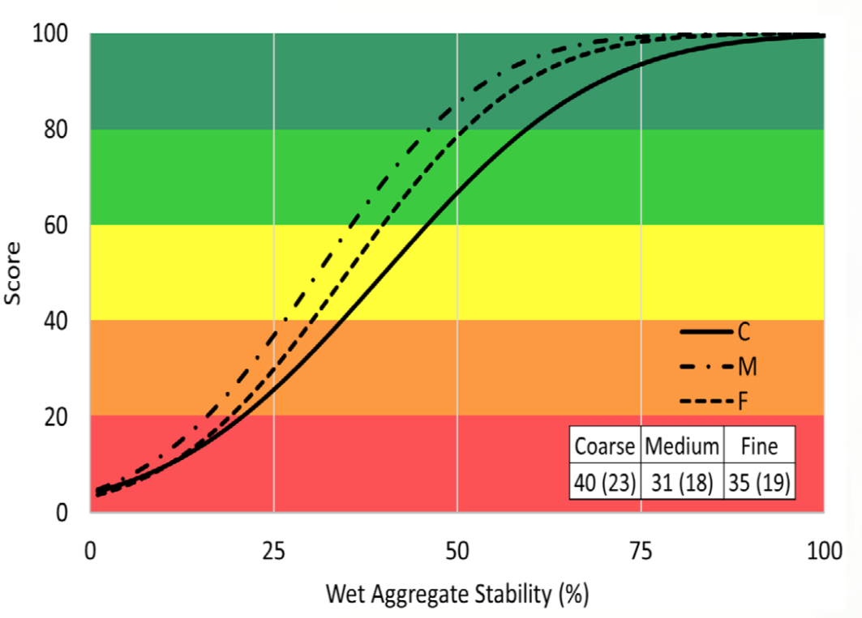
Python Analysis
Uploading Data -> Csv File
Utilizing Pandas for basic statistics analysis
Scatter Plot Comparing Variables
Creating a Function w/ the following equation to determine aggregation % of samples:
(%)={{WR-SW)/{[IW/(AD/OD)}-Sw}}X100
Figure 1 Comparison: Cornell University

Slide 6
Questions?

